Slide 1
V5R2
V1R1
Yang Lei (Employee ID: wx491993)
Feb 01, 2019

Slide 2
Storage Virtualization Basics

Slide 3
Data has become an enterprise’s most important asset. How is data stored on the cloud? How is this different from the way it is stored with traditional IT? This chapter will answer these questions.

Slide 4
Upon completion of this course, you will:
  Understand Huawei’s FusionSphere virtualization solution.
  Understand the storage architecture used for virtualized environments.
  Understand different types of disks.
  Understand the differences between centralized and distributed storage.
  Understand the differences between virtualized and non-virtualized storage.
  Understand different types of VM disks.
  Understand the storage features of Huawei’s virtualization product.

Slide 5
Storage Architecture for Virtualization
Physical Disk Types and Related Techniques
Centralized Storage vs. Distributed Storage
Virtualized Storage vs. Non-Virtualized Storage
Introduction to VM Disks
Storage Features of Huawei’s Virtualization Product

Slide 6
Where Do the Storage Resources Used by VMs Come From?
How do VMs access the underlying storage resources?
?
?

Slide 7
Storage Architecture for Virtualization
Virtualized storage
Non-virtualized storage
qcow
raw
vmdk
vhd
others
Shared Catalog
File System
Logical
Volumes
File System
Logical Division
NAS
Storage
SAN
Storage
Logical Division
Storage
Pool
Storage
Pool
Logical Division
Distributed
Storage Pool
Distributed
Storage

Slide 8
Virtualized Storage Conversion Path in Cloud Computing
Shared Catalog
Shared Catalog
Virtual file
system
Logical
volume
Attach to compute cluster and format
Physical
volume
Physical
volume
NFS file
system
Logical division
Format
RAID or Replication
Notes:
本页胶片在《虚拟化存储与非虚拟化存储》也有，讲师可根据实际情况或个人习惯，选择先将此页胶片展示给学员，然后在后面小节中详细讲解，或者隐藏此页。
This slide also appears in “Virtualized Storage vs Non-Virtualized Storage”. The lecturer can choose to show or hide this slide at his or her discretion.

Slide 9
Non-Virtualized Storage Conversion Path in Cloud Computing
Logical
volume
Attach to compute cluster
Physical
volume
Logical division
RAID or Replication
Notes:
和上页一样，本页胶片在《虚拟化存储与非虚拟化存储》也有，讲师可根据实际情况或个人习惯，选择先将此页胶片展示给学员，然后在后面小节中详细讲解，或者隐藏此页。
This slide also appears in “Virtualized Storage vs Non-Virtualized Storage”. The lecturer can choose to show or hide this slide at his or her discretion.

Slide 10
Storage Architecture for Virtualization
Physical Disk Types and Related Techniques
Centralized Storage vs. Distributed Storage
Virtualized Storage vs. Non-Virtualized Storage
Introduction to VM Disks
Storage Features of Huawei’s Virtualization Product

Slide 11
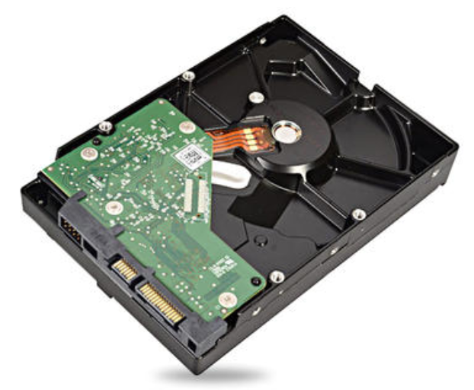
Physical Disk Type - SATA
SATA (Serial Advanced Technology Attachment), also called serial ATA, is a computer bus interface that connects host bus adapters to mass storage devices. Using serial communication, the serial ATA bus uses embedded clock signals to check transmission commands (not only data) and automatically corrects detected errors, ensuring reliable data transmission for SATA disks. The SATA interface is simple and the disks are hot-swappable.

Slide 12
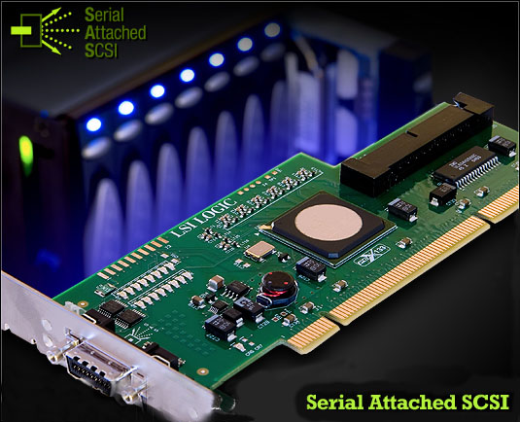
Physical Disk Type - SAS
Serial Attached SCSI (SAS) is a new-generation SCSI technology, which, like the popular Serial ATA (SATA), also uses serial communication to achieve a higher transmission speed. Compared with the older parallel SCSI, SAS improves the efficiency, availability, and scalability of storage systems and offers optional compatibility with SATA.

Slide 13
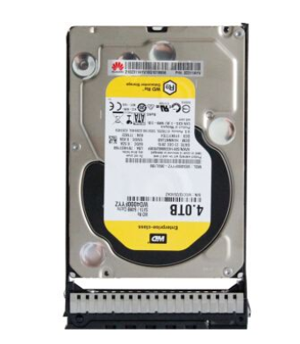
Physical Disk Type - NL-SAS
Nearline SAS (NL-SAS) disks are a combination of a SAS interface with SATA disks. The rotational speed of NL-SAS disks is only 7200 rpm, so performance is lower than that of SAS disks. However, with the SAS interface, addressing and speed are improved.

Slide 14
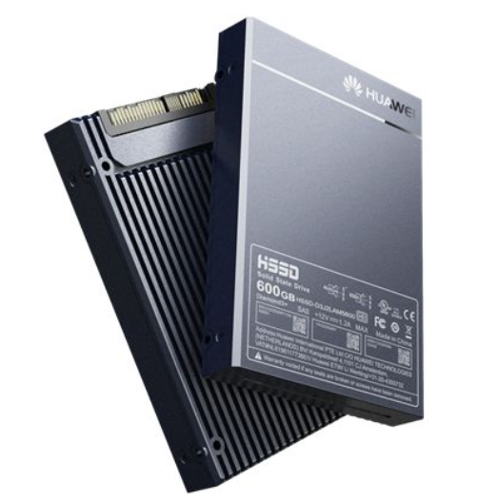
Physical Disk Type - SSD
A solid-state drive (SSD) is a solid-state storage device that uses integrated circuit assemblies as non-volatile memory. An SSD consists of a control unit and a storage unit (flash or DRAM chip). An SSD is the same as a common hard disk drive (HDD) in terms of interface specifications and definition, functionality, usage, and product shape and size. Although SSDs deliver fast read/write performance, light weight, low power consumption, and compact sizes which traditional HDDs cannot rival, SSDs have a shorter lifespan and higher price.

Slide 15


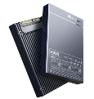

Comparing Different Types of Physical Disks
Performance
Price

Slide 16
Storage Architecture for Virtualization
Physical Disk Types and Related Techniques
Centralized Storage vs. Distributed Storage
Virtualized Storage vs. Non-Virtualized Storage
Introduction to VM Disks
Storage Features of Huawei’s Virtualization Product

Slide 17
Centralized Storage
Storage
Pool
Data read/write
Data read/write
Data read/write
Data read/write
RAID

Slide 18
RAID Technology
RAID
Efficient
Safe
Parallel read and write on multiple disks
Parity check and hot backup
1
2

Slide 19
Common RAID Types
Logical Disks
D0, D1, D2, D3, D4, D5
D0, D1, D2
Logical Disks
D5
D4
D4
D5
D2
D2
D2
D3
D2
D3
D1
D1
D1
D2
D0
D0
D0
D1
D0
D1
D0
Disk 1
Disk 2
Disk 1
Disk 2
RAID 0
RAID 1
RAID 5
RAID 6
P3
Logical Disks
D7
D6
Q3
D0, D1, D2, D3, D4, D5, D6, D7
D5
D5
D0, D1, D2, D3, D4, D5
D4
D4
Q2
P2
P2
Q3
D6
D7
P3
D3
D3
P2
D4
D5
P2
Q2
D4
D5
Q1
P1
D2
P1
D2
P1
P1
D2
D3
Q1
D3
D2
P0
D0
D1
P0
D0
D1
P0
Q0
Q0
D1
P0
D0
Disk 1
Disk 2
Disk 3
Disk 1
Disk 2
Disk 3
Disk 4
D1
D0

Slide 20
Centralized Storage Types
SAN
NAS
Windows
client
Unix-like
client
IP/FC network
CIFS
NFS
Windows server
NAS
Unix-like
server

Slide 21
IP SAN & FC SAN
User A
User B
User C
User A
User B
User C
LAN
LAN
Server
Server
Server
Server
iSCSI
FC
TCP/IP network
Ethernet switch
FC network
FC switch
Storage device
Storage device
Storage device
Storage device
IP SAN is a storage area network architecture that is built on Ethernet and uses TCP/IP as the underlying transport protocol. The typical protocol that implements IP SAN is iSCSI. It defines how SCSI instruction sets are encapsulated during IP transmission.
Servers and storage devices are directly connected through FC switches.

Slide 22
IP SAN vs FC SAN
Description | IP SAN | FC SAN
Network speed | 1 Gbit/s, 10 Gbit/s, 40 Gbit/s | 4 Gbit/s, 8 Gbit/s, 16 Gbit/s
Network architecture | Existing IP networks | Dedicated FC network and HBA card
Transmission distance | No limit in theory | Limited by the transmission distances of optical fibers
Management and maintenance | Simple operations like those with IP devices | Complex techniques and management
Compatibility | Compatible with all IP network devices | Poor compatibility
Performance | 1 Gbit/s is the current mainstream; 10 Gbit/s is emerging. | High transmission and read/write performance
Cost | Low purchase and maintenance costs | High purchase costs (FC switches, HBA cards, FC disk arrays, etc.) and maintenance costs (personnel training, system configuration and monitoring)
DR | Built-in local and remote disaster recovery capability at low costs | High hardware and software costs for DR
Security | Relatively low | High

Slide 23
NAS Architecture
Ethernet Interface
Ethernet Interface
Network file system protocol (NFS/CIFS)
File System
Volume Management Module
Volume Management Module
LUN0
LUN1
LUN2
LUN3
LUN4
LUN5
LUN6
LUN7
LUN8
LUN9
LUN10
LUN11

Slide 24
CIFS
Common Internet File System (CIFS) is a shared open file system developed from Microsoft’s Server Message Block (SMB). In a Windows OS, you can mount shared resources on the CIFS server to your own system by creating a simple shared mapping. Then you can use the shared resources as if using local resources.

Slide 25
NFS
Network File System (NFS) was originally developed by Sun Microsystems. It can be used for cross-network file sharing in UNIX-like operating systems such as Linux/UNIX/AIX/HP-UX/Mac OS X. You can use the mount command to mount remote file systems to your own file system, and access the remote shared files as if accessing local files.

Slide 26
CIFS vs NFS
 | CIFS | NFS
Transmission | Network-based, high reliability requirements | Transmission-independent
Ease of use | No additional software required | Dedicated software required
Security | No error correction | Error correction supported
File conversion | No file format retained. | File format retained

Slide 27
Distributed Storage
Distributed
Storage
Pool
Data read/write
Data read/write
Data read/write
Data read/write
Replication

Slide 28
Replication
Data write
Distributed
Storage Pool

Slide 29
Replication
Data write
Data read
Distributed
Storage Pool
Distributed
Storage Pool

Slide 30


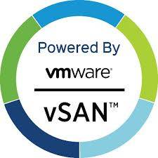

Popular Distributed Storage Products

Slide 31
Storage Architecture for Virtualization
Physical Disk Types and Related Techniques
Centralized Storage vs. Distributed Storage
Virtualized Storage vs. Non-Virtualized Storage
Introduction to VM Disks
Storage Features of Huawei’s Virtualization Product

Slide 32
Virtualized Storage Conversion Path in Cloud Computing
Shared Catalog
Shared Catalog
Virtual file
system
Logical
volume
Attach to compute cluster and format
Physical
volume
Physical
volume
NFS file
system
Format
Logical division
RAID or Replication

Slide 33
Non-Virtualized Storage Conversion Path in Cloud Computing
Logical
volume
Attach to compute cluster
Physical
volume
Logical division
RAID or Replication

Slide 34
Relationship Between RAIDs and LUNs
A RAID array can be seen as a large physical volume made up of a number of hard disks.
On top of a physical volume, you can create one or more logical units of specified capacities. These logical units are called Logical Unit Numbers (LUNs) and can be mapped to hosts as basic block devices.
Logical volume
LUN 1
Logical volume
LUN 2
LUN 3
Physical volume
Physical volume
Create one logical volume on a single physical volume
Create multiple logical volumes on a single physical volume

Slide 35
Process of Creating a LUN
LUN 1
LUN 2
LUN 3
Logical volume
Logical division
Physical volume
Segmentation
RAID
Hard disk

Slide 36

Pool & Volume & LUN
A storage pool is a container of storage resources. The storage resources used by application servers all come from storage pools.
A volume is an internal object managed inside a storage system.
A LUN is a storage unit that can be directly mapped to a host for data read and write. It is how volumes are provisioned to application servers.
Server
LUN
Pool
Volume

Slide 37

Common File Systems
Virtual clustered file system
NAS file system
File system in an OS

Slide 38
Mapping a File to a Disk
Create
Store
Mapping via file system
User
File
File system
File system blocks
Mapping
Mapping
Mapping via LVM
Disk sectors
Physical locations on disks
Logical locations of LVM

Slide 39
Storage Architecture for Virtualization
Physical Disk Types and Related Techniques
Centralized Storage vs. Distributed Storage
Virtualized Storage vs. Non-Virtualized Storage
Introduction to VM Disks
Storage Features of Huawei’s Virtualization Product

Slide 40
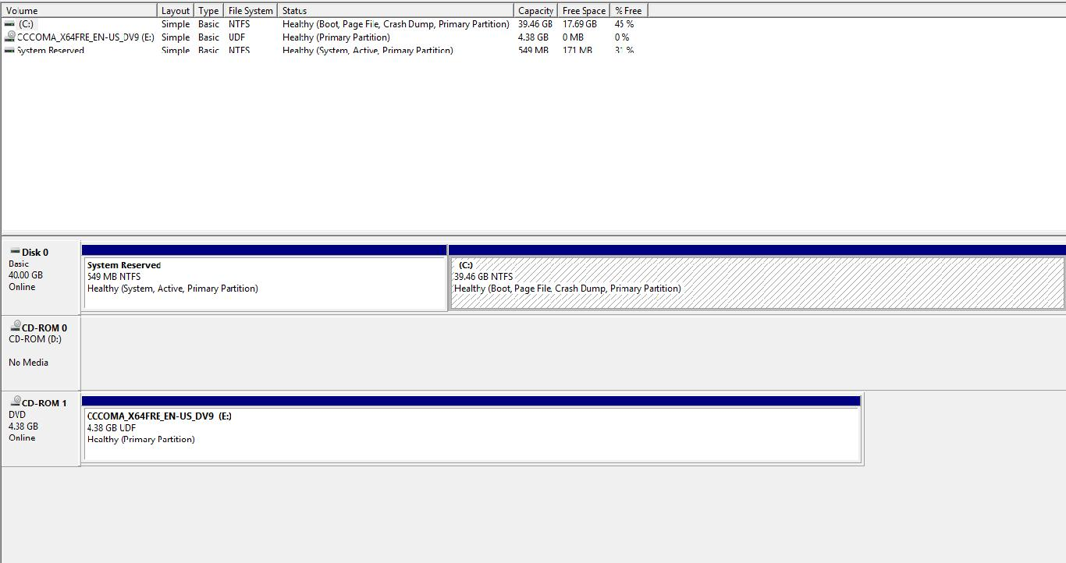
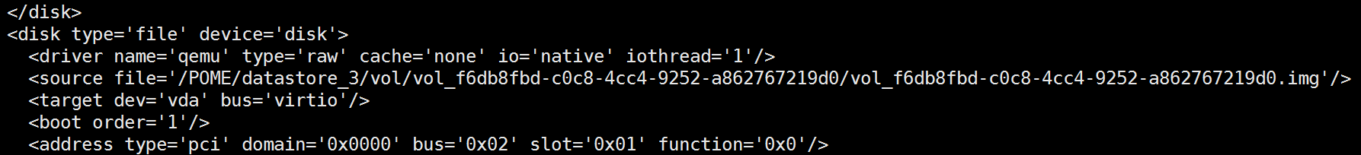
VM Disks
User view
Administrator view
Notes:
虚拟机磁盘是文件系统上的一个文件，对于一个客户操作系统而言，就好像是一个物理磁盘驱动器。这个文件既可以在主机上，也可以在一个远端文件系统上。在给虚拟机配置虚拟磁盘后，可以安装一个新的操作系统到该磁盘文件。

Slide 41
Common VM Disk Formats
VM Disk File Format | Vendor
RAW | All
VMDK | VMware
VHD | Microsoft Hyper-V, Huawei FusionCompute
QCOW | QEMU or KVM virtualization platforms only
QED
VDI | Oracle

Slide 42
Storage Architecture for Virtualization
Physical Disk Types and Related Techniques
Centralized Storage vs. Distributed Storage
Virtualized Storage vs. Non-Virtualized Storage
Introduction to VM Disks
Storage Features of Huawei’s Virtualization Product

Slide 43
Storage Architecture for Huawei Virtualization Product
Virtualized storage
Non-virtualized storage
RDM
Data store
LUN
Shared catalog
Storage device
FusionStorage
Block
SAN/NAS
Storage resource

Slide 44
Huawei Virtual Disk Features
Type
Common
Shared
Multi-tenant sharing
Space-saving
Configuration Mode
Common
Thin-provision
Temporary data storage
Customer needs
Fast read/write
Disk Mode
Dependent
Independent & persistent
Independent & nonpersistent

Slide 45
At this point you should understand how data is written to storage devices in virtualization scenarios.

Slide 46
Which of the following disk types is recommended for an archive room that needs to store large amounts of data that will be accessed infrequently over long periods of time? ( )
  A. SSD
  B. SAS disk
  C. SATA disk
  D. NL-SAS disk
SATA disks use a parallel interface while SAS disks use a serial interface.
  A. TRUE
  B. FALSE
Notes:
参考答案：

Slide 47
Huawei e-Learning website
  http://support.huawei.com/learning/Index!toTrainIndex
Huawei Support case library
  http://support.huawei.com/enterprise/servicecenter?lang=en
HCIA-Cloud Computing v4.0 online forum
  https://forum.huawei.com/enterprise/en/Huawei-Official-Communication-Channel-HCNA-Cloud-Certification-Course/thread/456287-911

